Slide 1
Why do you need version control?
By Shahbaz Chaudhary

Slide 2
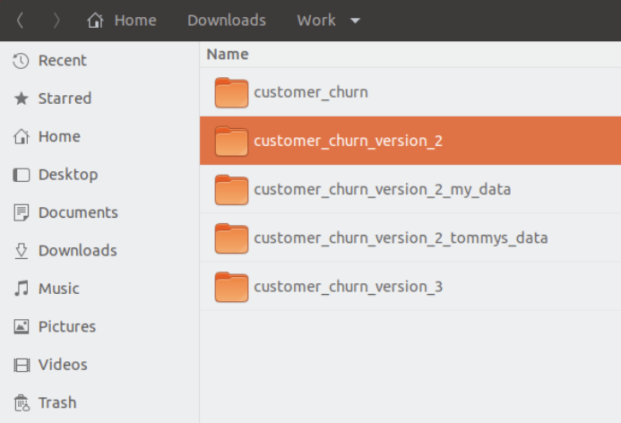
1. Version control remembers history
Version control remembers every change you make to your project.
You can make comments about the reason you changed something.
You can go back in time to any change.
You can even have multiple timelines – people working on different versions of code.
All in a single directory

Slide 3
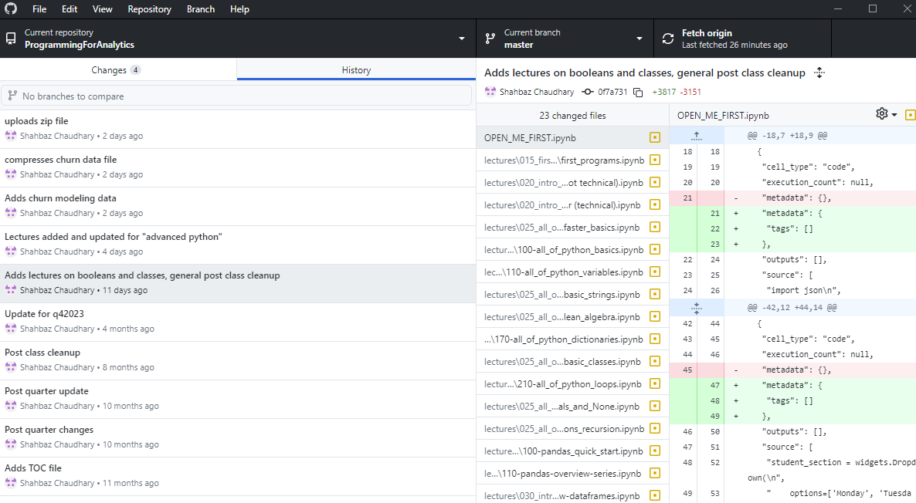
1. Version control remembers history

Slide 4
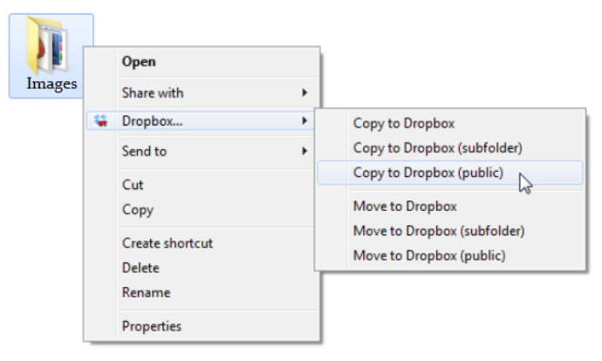
2. A remote repository can serve as a backup
You can replicate the full history of your version-controlled repository to a remote server. Your collaborators can pull this repository, along with its full history.

Slide 5
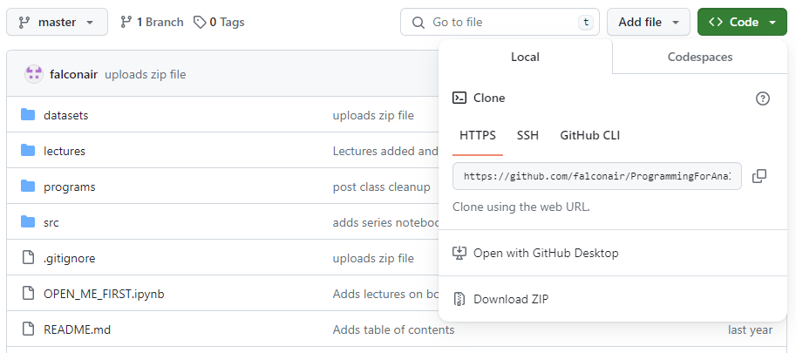
2. A remote repository can serve as a backup

Slide 6
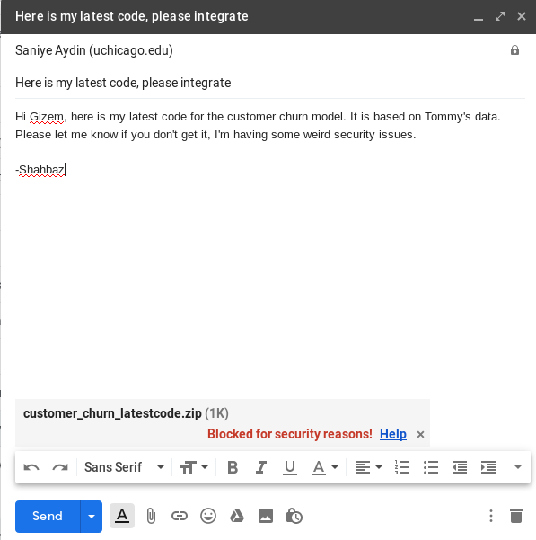
3. A web-based service can make collaboration easier
Modern repository services, such as GitHub and BitBucket make it very easy to collaborate.
Linus Torvalds actually created git for internet scale collaboration for the Linux kernel (story time).
These services further provide space for task management and other services

Slide 7
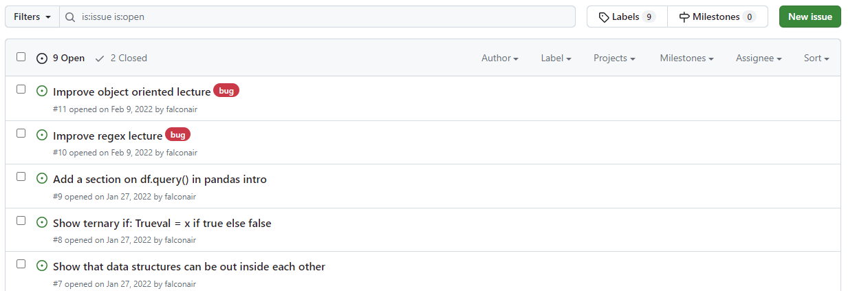
3. A web-based service can make collaboration easier

Slide 8
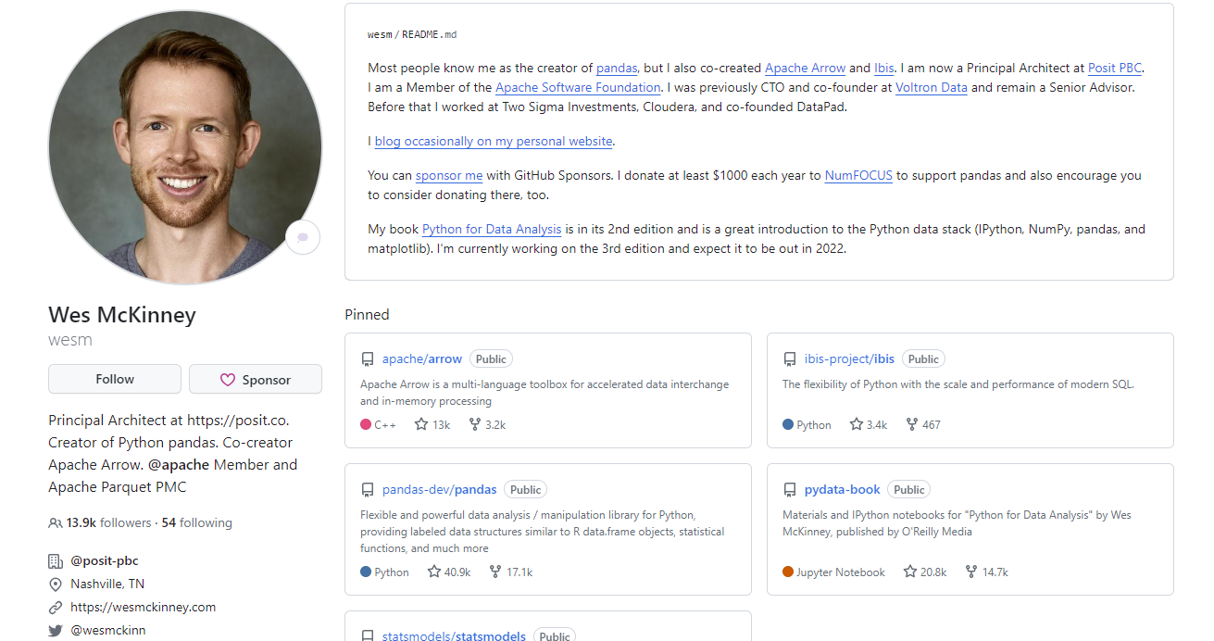
4. GitHub is also the modern resume (along with Linked-In)
Employers often ask for a public GitHub link to see actual code examples.
Use it to showcase class projects, side-gigs, even little blurbs about yourself.
But DON’T misrepresent your work! I have personally found examples of copied code!

Slide 9
Hands on keyboard …

Slide 10
Install Git https://git-scm.com/downloads
Some nice GUIs cataloged at: https://git-scm.com/downloads/guis
GitHub has a very minimal GUI (seen earlier): https://desktop.github.com/
Jupyter Lab has a well integrated Git extension: https://github.com/jupyterlab/jupyterlab-git
VS Code has a built-in Git extension

Slide 11
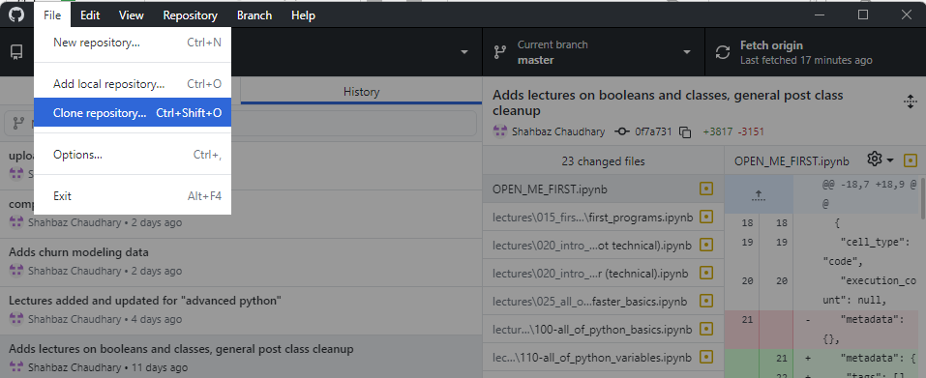
Clone a repository https://github.com/falconair/ProgrammingForAnalytics
Using GitHub Desktop
Using the command line
git clone https://github.com/falconair/ProgrammingForAnalytics.git

Slide 12
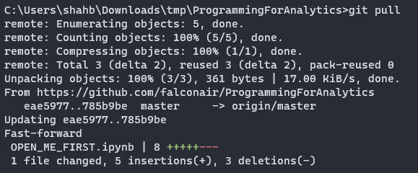
Get latest changes with git pull
Me
git clone
git pull
You

Slide 13
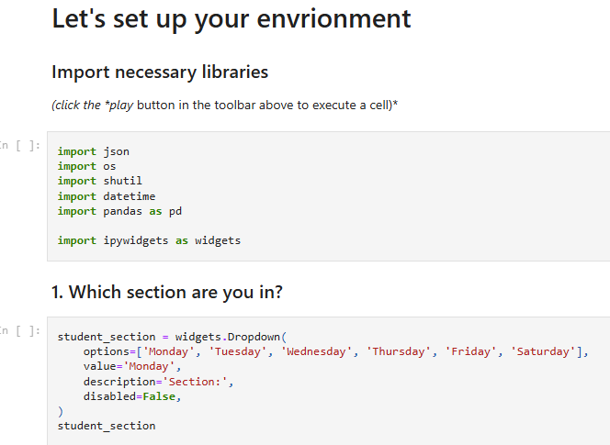
Reminder: Jupyter notebooks are just JSON
{
"cells": [
{
"cell_type": "markdown",
"metadata": {},
"source": [
"# Let's set up your envrionment"
]
},
{
"cell_type": "markdown",
"metadata": {},
"source": [
"### Import necessary libraries \n",
"*(click the *play* button in the toolbar above to execute a cell)*"
]
},

Slide 14
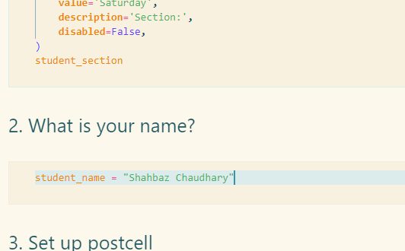
You update README.md
I also update README.md

Slide 15
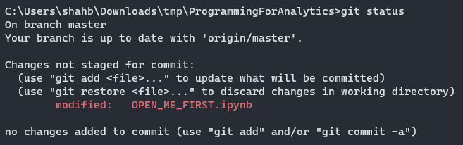
Get latest changes with git pull,again
My edit
Me
git clone
git pull
Your edit
You

Slide 16
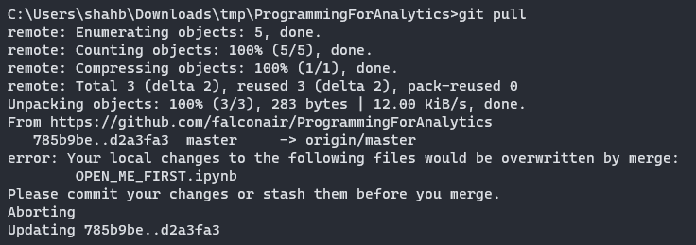
Get latest changes with git pull,again
Conflict!
My edit
Me
git clone
git pull
git pull
Your edit
You

Slide 17
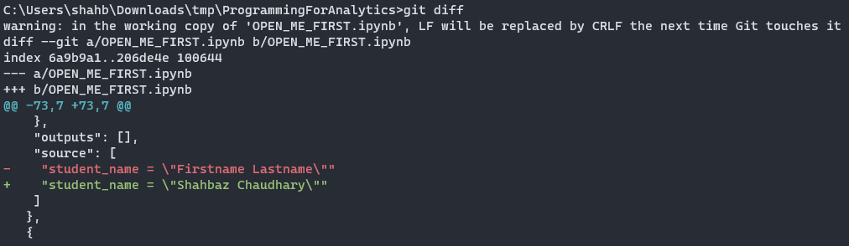
More detail with git diff
Conflict!
My edit
Me
git clone
git pull
git pull
Your edit
You

Slide 18
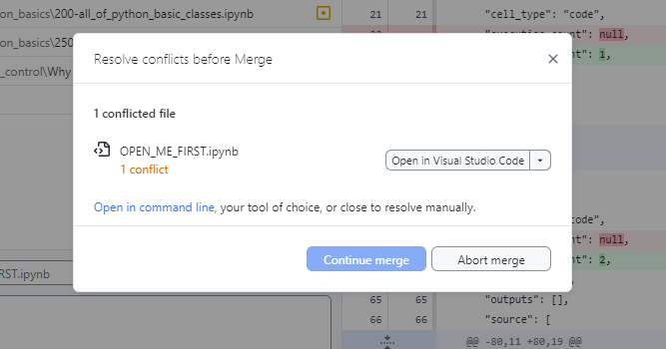
Either resolve the merge conflict
Conflict!
My edit
Me
git clone
git pull
git pull
Your edit
You

Slide 19
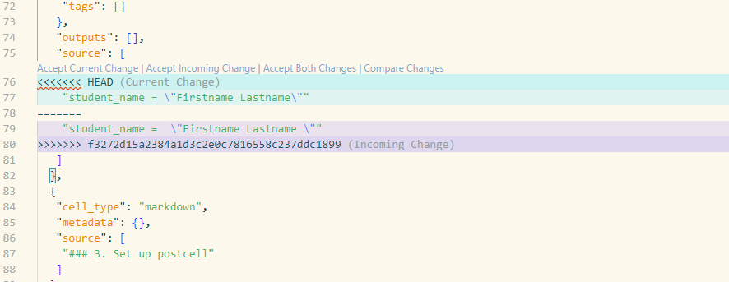
Sometimes by manually picking changes
Conflict!
My edit
Me
git clone
git pull
git pull
Your edit
You

Slide 20

…or just overwrite the local file

Slide 21
The story so far: git clone|pull|diff
Download repository to your laptop: git clone
Get latest changes: git pull
Merge conflicts happen when there are conflicting changes in a file. The git diff command can give more details, but most of us should switch to GUI tools to resolve conflicts.
Resolving a merge conflict, although scary sounding, just means that a human needs to decide which changes to keep.

Slide 22
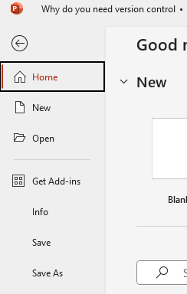
Save your work with git commit
Many software packages require periodic use of a “save” command to make sure your work is not lost when the application closes.
Similarly, git commit records all changes in a chronological manner. Since git doesn’t over-write snapshots, annotating the save with a comment provide a log book of changes.

Slide 23
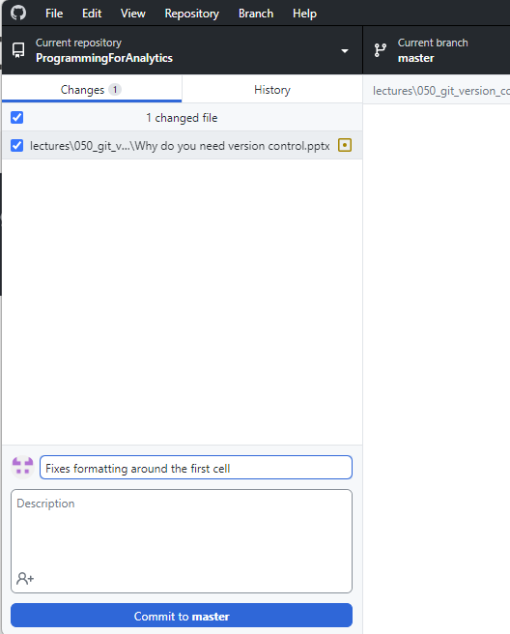
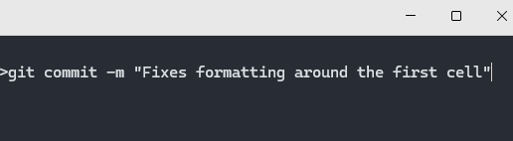
Two ways to do git commit – m “…”

Slide 24

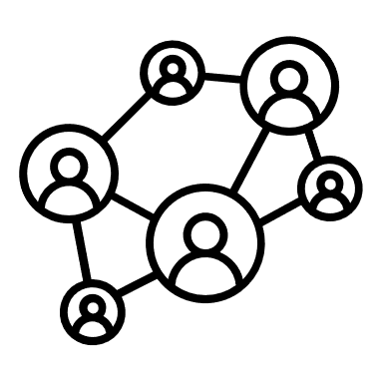

Git is a distributed version control system
When you clone a repository, you are pulling down all the files and their history.
You then operate only on the local copy. If you want to sync the changes, you have to explicitly push the changes back.
Git operates as a giant network of peers, not as a remote/local hierarchy

Slide 25
You must send your changes to GitHub via git push
git commit only records changes on your local computer.
In order to share your changes with your colleague or protect them against local machine failure, you must send your changes to a remote server with git push

Slide 26
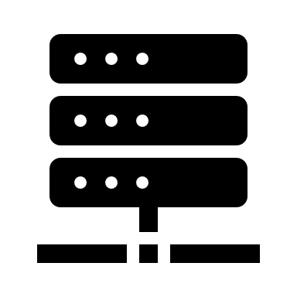

Recap: clone, pull, diff, commit, push
git clone <repo>
Downloads the repo to laptop

Slide 27
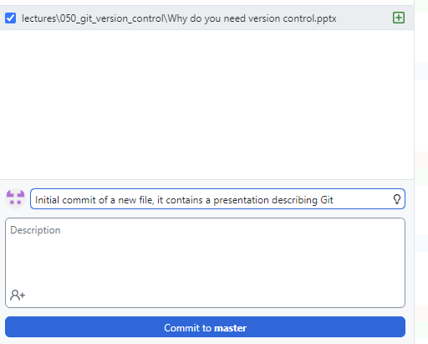
Create a repo, git commit and git push to it
So far, we have had only one way interactions with repositories. Now we need to go the other way.
Create an account on GitHub (pick your name wisely, it will be your internet identity)
Create a new repository
Clone it
Add a new file to it
How has the status changed?
1. “Commit” file to version control
2. “Push” file to remote repository

Slide 28
For a future episode…

Slide 29
More commands
git commit –m “fixed bug #123”
git push
git reset
git branch
git …

